Slide 1
Unit-3 : Requirement Engineering
If a company wishes to let a contract for a large software development project, it must define its needs in a sufficiently abstract way that a solution is not predefined.
The requirements must be written so that several contractors can bid for the contract, offering, perhaps, different ways of meeting the client organization’s needs.
Once a contract has been awarded, the contractor must write a system definition for the client in more detail so that the client understands and can validate what the software will do. Both of these documents may be called the requirements document for the system.

Slide 2
Requirements in General
The term ‘user requirements’ to mean the high-level abstract requirements and ‘system requirements’ to mean the detailed description of what the system should do. They are defined as follows:
1.User requirements are statements, in a natural language plus diagrams, of what services the system is expected to provide to system users and the constraints under which it must operate.
2.System requirements are more detailed descriptions of the software system’s functions, services, and operational constraints. The system requirements document (sometimes called a functional specification) should define exactly what is to be implemented. It may be part of the contract between the system buyer and the software developers.

Slide 3
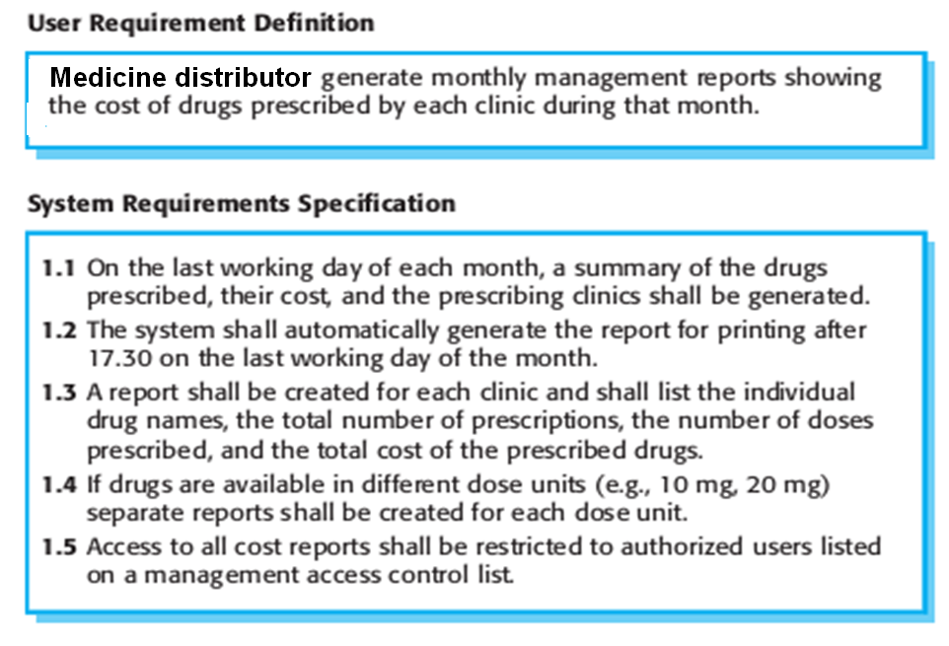
Example : Showing related requirements

Slide 4
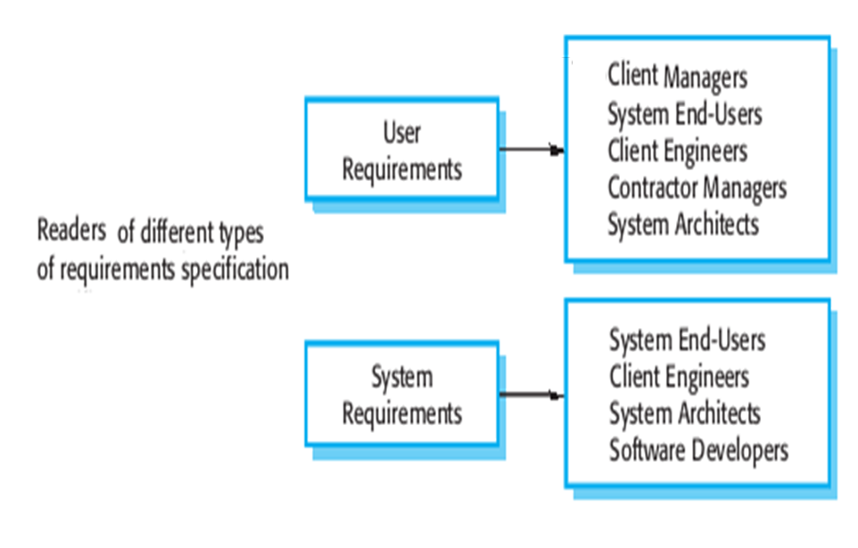
Requirement Readers of the domain
Software Engg. Followed hierarchy:

Slide 5
Responsibilities of Requirement Readers
In smaller projects, client's engineer is also responsible for contracts and will be called an assistant project manager. A similar role is also known as owner's engineer, but by inference, often act more in the interests of the software developer.
Systems Architects divide large and complex systems into manageable subsystems that can be handled by individual engineers. ... Systems architects define the architecture of a computerized system (i.e., a system composed of software and hardware) in order to fulfill certain requirements.

Slide 6
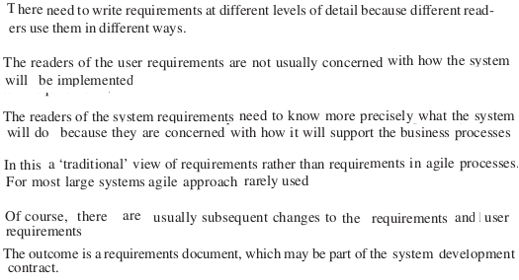
Requirements and Agile Methodology ?

Slide 7
Requirement Classification - based on Functionality
Software system requirements are often classified as functional requirements or nonfunctional requirements:
Functional requirements: These are statements of services the system should provide, how the system should react to particular inputs, and how the system should behave in particular situations. In some cases, the functional requirements may also explicitly state what the system should not do.
Non-functional requirements: These are constraints on the services or functions offered by the system. They include timing constraints, constraints on the development process, and constraints imposed by standards. Non-functional requirements often apply to the system as a whole, rather than individual system features or services.

Slide 8
The functional requirements for a system describe what the system should do. These requirements depend on the type of software being developed,
When expressed as user requirements, functional requirements are usually described in an abstract way that can be understood by system users.
More specifically functional requirements describe the system required functions, like inputs and outputs, exceptions, etc., in detail.
Ideally, functional requirements of system specification should be complete and consistent.
Completeness means all user required services should be defined. Consistency means requirements should not have contradictory

Slide 9
Non-functional requirements, as the name suggests, are requirements that are not directly concerned with the specific services delivered by the system to its users.
Non-functional requirements, such as performance, security, or availability, usually specify or constrain characteristics of the system as a whole.
Non-functional requirements are often more critical than individual functional requirements.
Failing to meet a non-functional requirement can mean that the whole system is unusable.
It is often possible to identify which system components implement specific functional requirements. But it is often more difficult to relate components to non-functional requirements.
Example: to ensure that “performance” (non-functional) requirements are met, we may have to organize the system to minimize “communications” (Functional requirement) between components.

Slide 10
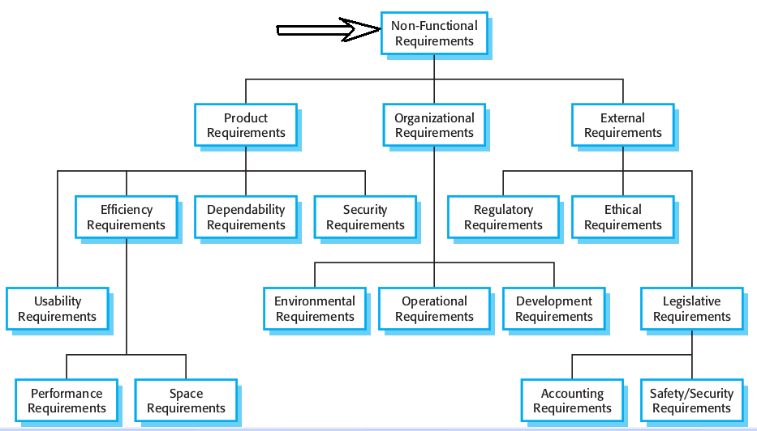

Slide 11
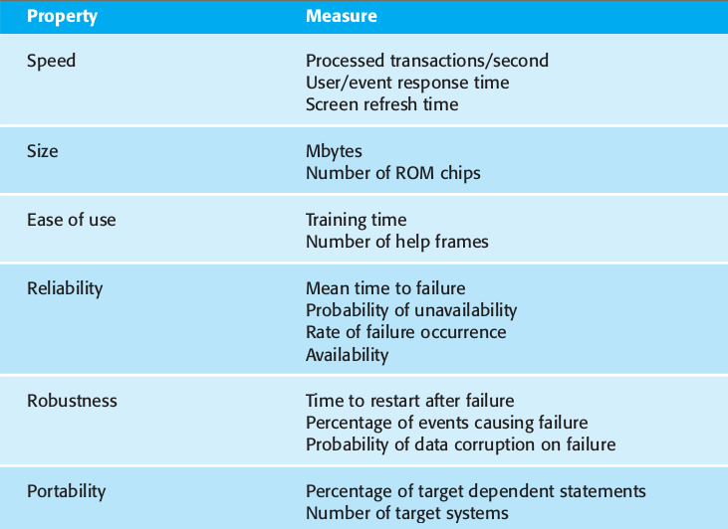
It is preferable writing non-functional requirements quantitatively. Accordingly the objectives can be tested using following parameters,

Slide 12
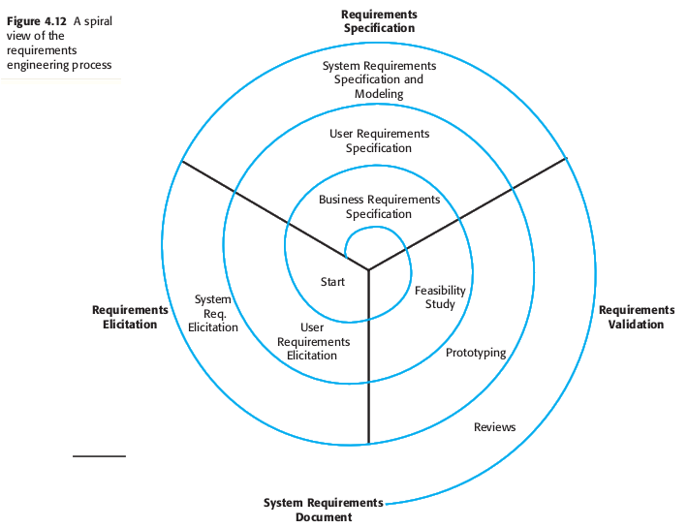

Slide 13
The Requirements Document
The requirements document is the official statement of what is required of the system developers.
Should include both a definition of user requirements and a specification of the system requirements.
It is NOT a design document. As far as possible, it should set of WHAT the system should do rather than HOW it should do it

Slide 14
IEEE -Requirements Standard
Defines a generic structure for a requirements document that must be instantiated for each specific system.
  Introduction.
  General description.
  Specific requirements.
  Appendices.
  Index.

Slide 15
Software Requirements Document
The software requirements document (sometimes called as the software requirements specification or SRS) is an official statement of what the system developers should implement.
It should include both the user requirements for a system and a detailed specification of the system requirements.
If there are a large number of requirements, the detailed system requirements may be presented in a separate document.
The requirements document has a diverse set of users, ranging from the senior management of the organization that is paying for the system to the engineers responsible for developing the software.

Slide 16
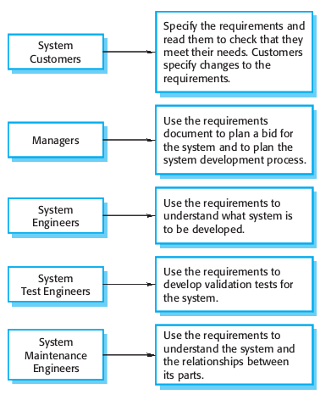
Software Requirements Document Users

Slide 17
Requirements document structure
Preface
Introduction
Glossary
User requirements definition
System architecture
System requirements specification
System models
System evolution
Appendices
Index

Slide 18
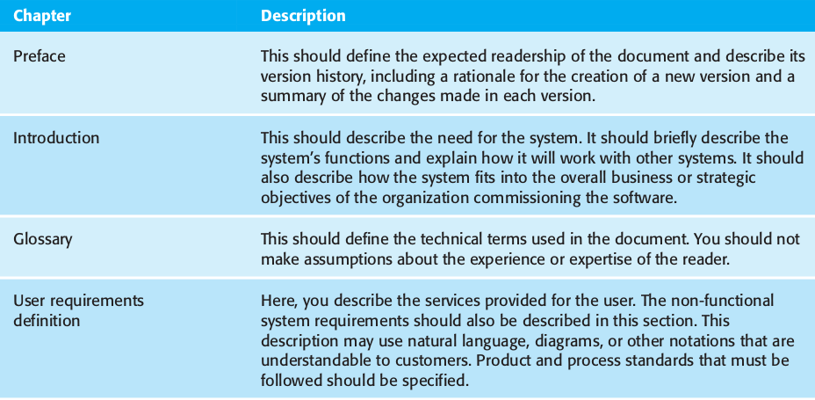

Slide 19
